Slide 1



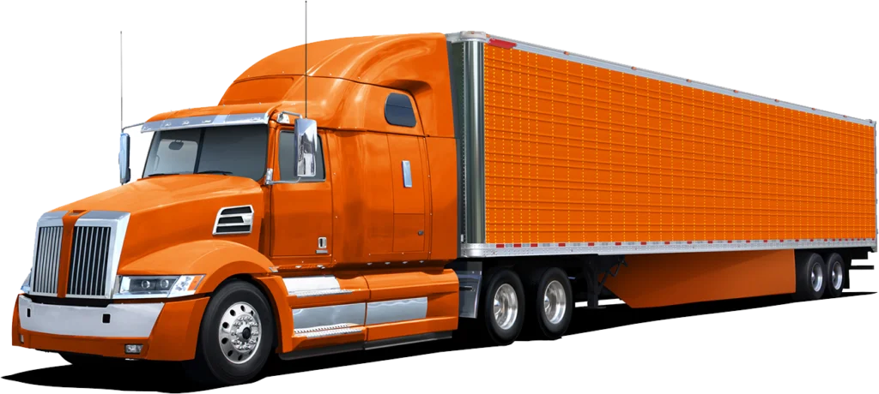

LogiTech Finance & Audit Institute
CLASS 1
ALL ABOUT DRIVERS
© 2024 | MASTER CDL

Slide 2
LogiTech Finance & Audit Institute
CLASS AGENDA
Truck Drivers and types of CDL Licenses (Steps to get a CDL License)
Driver File Check List
© 2024 | MASTER CDL

Slide 3
Checklist Driver File
Template
Previous Employment Verification
Pre Employment Drug Alcohol Test
Check Listed in National Register
1
3
MVR
5
7
9
2
4
6
8
Commercial
Driver’s License
Inquire for State Agency for Personal Data
Medical Certificate
Pre Employment Testing Notification and Consent
Certificate
of Road Test
Drug and Alcohol
Policy
Application for Employment
10
12
14
Annual MVR
16
Warning Notice
18
11
13
15
17
Training Report
Safety History Records Request
Contracts
Annual Certificate of Violation
Termination
Letter

Slide 4
Checklist Company File
Template
1
Pre Employment Drug Alcohol Test
Check Listed in National Register
3
MVR
5
7
Commercial
Driver’s License
2
4
6
Inquire for State Agency for Personal Data
Medical Certificate
Pre Employment Testing Notification and Consent

Slide 5

LogiTech Finance & Audit Institute
COMMERCIAL DRIVER’S LICENSE
A Commercial Driver's License (CDL) is a specialized license required in the United States for drivers who operate any type of vehicle that carries large quantities of goods or a large number of passengers.
© 2024 | MASTER CDL

Slide 6

Steps to get a CDL License
Provide proof of state and U.S. residency.
Upon competition, the applicant will receive a CLP. After successfully passing the examinations, the applicant will receive the appropriate CDL type.
Be at least 21 years old (at least 16 years old fo intrastate government)
Submit an application to the CDL of the state in which the applicant is located and pay the application fee
Submit completed Medical Examination Report Form and Medical Expert
Provide proof of identity and social security numbers.
Submit an eye test.

Slide 7
CDL CLASSES
CLASSB
CLASSA
CLASSC
A Class B commercial driver’s license is required to operate a single vehicle with a gross combination weight rating of 26,001 or more pounds, or tow a vehicle not heavier than 10,000 pounds.
A Class C commercial driver’s license is required to operate a vehicle that is designed to transport 16 or more occupants (including the driver) or transport hazardous materials (HazMat).
A Class A commercial driver’s license is required to operate any combination of vehicles with a gross combination weight rating (GVWR) of 26,001 or more pounds, provided the towed vehicle is heavier than 10,000 pounds

Slide 8



WHAT COMES WITH CLASSES
B
A
Straight trucks or/and Tractor-Trailer
Large passnger buses
Segment buses
Box trucks
Dump trucks with small trailers
C
Tractor-trailers
Truck and trailer combinations
Tank vehicles
Livestock carriers
Flatbeds
Small HazMat vehicles.
Passenger vans.
Tank Trucks.
Double/Triple Trailers.
Combination vehicles.

Slide 9

How to verify a driver’s CDL
7 steps explained
Expiration and Validity
Authenticity Checks
Medical Certification
1
2
3
4
5
6
7
CDL Type and Class Verification
Endorsements and Restrictions
State Verification
State Verification

Slide 10


Check the Type: Ensure the CDL is appropriate for the type of vehicle the driver will operate (Class A, B, or C).
CDL CHECK
Class A allows operation of any combination of vehicles with a gross vehicle weight rating (GVWR) of 26,001 or more pounds, provided the GVWR of the vehicle(s) being towed is greater than 10,000 pounds.
CDL Type and Class Verification:
Verifying a truck driver's Commercial Driver’s License (CDL) is a critical step in the hiring process to ensure that the candidate is legally qualified to operate commercial vehicles.
Class B is for any single vehicle that isn't hitched to a trailer (these vehicles include box trucks, large buses, and dump trucks).
Class C is for any single vehicle, or combination of vehicles, that doesn’t meet the criteria of Class A or B but is designed to transport 16 or more passengers including the driver, or is transporting material that has been designated as hazardous under federal law.
1

Slide 11

2
3
4
CDL CHECK
Expiration and Validity:
Endorsements and Restrictions:
Authenticity Checks:
State Verification:
Medical Certification:
Record of Violations:
Ensure the CDL is current and has not expired.
Check for specific endorsements that are required for different types of cargo and vehicles, such as H (Hazardous materials), N (Tank vehicles), P (Passenger vehicles), S (School buses), T (Double/triple trailers).
Physical Inspection: Examine the physical CDL for signs of alteration or fraud.
State Database: Use the issuing state’s Department of Motor Vehicles (DMV) database to verify the license. Most states have online systems where employers can verify driver licenses.
Check Medical Status: Verify that the driver has a current medical examiner’s certificate, as required by the Department of Transportation (DOT), which demonstrates they are physically qualified to drive a commercial vehicle.
Driving Record: Obtain a copy of the driver’s motor vehicle record (MVR) from the state DMV to review any traffic violations, accidents, or suspensions. This also helps to verify that the CDL has not been revoked or suspended.
Confirm that the license is valid with no current suspensions, revocations, or disqualifications.
Look for any restrictions that might limit the types of vehicles or conditions under which the driver is allowed to operate. For example, a common restriction is the requirement to wear corrective lenses.
Security Features: Check for the presence of security features such as watermarks or holograms that indicate the license is authentic.
National Database: Utilize the Commercial Driver’s License Information System (CDLIS), which helps employers ensure that applicants do not have more than one CDL and no previous disqualifications or suspensions in other states.
5
6
7

Slide 12
Checklist Company File
Template
Pre Employment Drug Alcohol Test
Check Listed in National Register
1
3
MVR
5
7
4
6
CDL
Inquire for State Agency for Personal Data
Medical Certificate
Pre Employment Testing Notification and Consent
2

Slide 13
LogiTech Finance & Audit Institute
PRE EMPLOYMENT DRUG ALCOHOL TEST
Pre-employment drug and alcohol testing is a critical requirement in the trucking industry to ensure that drivers are capable of safely operating commercial vehicles. The U.S. Department of Transportation (DOT) mandates these tests for safety-sensitive transportation employees, which includes truck drivers holding Commercial Driver’s Licenses (CDLs).
© 2024 | MASTER CDL

Slide 14
1
2
3
Pre Employment Drug Alcohol Test
Legal Requirements
Substances Tested
Testing Procedures
Medical Review Officer Involvement
Result Reporting
Consequences of Positive Tests
Under the regulations set by the Federal Motor Carrier Safety Administration (FMCSA), part of the DOT, all prospective CDL drivers must undergo drug and alcohol testing before being permitted to operate a commercial vehicle on public roads.
Once the laboratory completes testing, the results are sent to a Medical Review Officer (MRO). The MRO reviews the results to ensure their accuracy.
If a test is positive, the MRO contacts the driver to determine if there is a legitimate medical explanation, such as a prescribed medication, that may have led to the positive result.
If the result is verified as positive by the MRO, the employer is notified. Employers cannot allow a driver who has tested positive, or refused to take a test, to perform safety-sensitive functions, such as operating a commercial vehicle.
Drivers who test positive, or refuse to undergo the pre-employment tests, must be removed from safety-sensitive duties.They cannot return to driving commercial vehicles until they have:
Undergone an evaluation by a substance abuse professional (SAP).
Completed any prescribed treatment.
Passed a return-to-duty drug and alcohol test.
Agreed to undergo follow-up testing.
The standard DOT 5-panel drug test checks for the following substances:
Marijuana (THC)
Cocaine
Amphetamines and methamphetamines
Opiates (including heroin, codeine, morphine, hydrocodone, hydromorphone, oxycodone, and oxymorphone)
Phencyclidine (PCP)
Collection: Samples are typically collected through urine tests, conducted at a certified testing facility.
Alcohol Testing: Alcohol testing is done using a breathalyzer or saliva test. The FMCSA prohibits drivers from having an alcohol concentration of 0.04% or greater.
4
5
6

Slide 15
Checklist Company File
Template
3
1
Pre Employment Drug Alcohol Test
5
Check Listed in National Register
7
MVR
4
6
2
Inquire for State Agency for Personal Data
CDL
Medical Certificate
Pre Employment Testing Notification and Consent

Slide 16
LogiTech Finance & Audit Institute
INQUIRY FOR STATE AGENCY FOR PERSONAL DATA
Inquiring with a State Agency for Personal Data as part of the hiring process for truck drivers involves checking various records and databases to ensure the suitability and compliance of candidates. This can include driving records, criminal history, and other personal data managed by state agencies.
© 2024 | MASTER CDL

Slide 17
Driving History: To assess the driver’s safety record, including accidents, traffic violations, and any license suspensions or revocations.
Purpose of Inquiry
Criminal History: To identify any criminal records that might affect the driver’s suitability for transporting goods, especially hazardous materials or operating in sensitive environments.
License Verification: To confirm that the driver possesses a valid Commercial Driver’s License (CDL) and any necessary endorsements.

Slide 18
Checklist Company File
Template
Motor Vehicle Record
1
Pre Employment Drug Alcohol Test
3
5
Check Listed in National Register
7
6
2
Inquire for State Agency for Personal Data
4
Medical Certificate
Pre Employment Testing Notification and Consent
CDL

Slide 19
LogiTech Finance & Audit Institute
MOTOR VEHICLE RECORD
An MVR, or Motor Vehicle Record, is a report that details a driver's driving history, including traffic citations, accidents, DUI convictions, and license suspensions. This record is maintained by the Department of Motor Vehicles (DMV) or equivalent state agency in each state in the United States. It is a crucial document often reviewed by employers, especially in industries where driving is a primary job function, such as trucking.
© 2024 | MASTER CDL

Slide 20
IMPORTANCE OF MVR IN THE TRUCKING INDUSTRY
COMPL-IANCE
INSURA-NCE
SAFETY
Federal and state regulations often require that commercial drivers maintain a clean driving record. Checking the MVR helps employers comply with these laws.
Insurance rates for commercial vehicles can be significantly affected by the driving records of the drivers employed. Employers often seek drivers with clean MVRs to keep insurance premiums lower.
Ensuring that the driver has a clean and safe driving record reduces the risk of accidents.

Slide 21
What's Included in an MVR?
An MVR includes, but is not limited to, the following information:
Driver’s License Status: Details about the driver’s license type, current status (valid, expired, suspended, or revoked), and expiration date.
Accident Reports: Any recorded accidents that involved the driver.
Driver’s License Status: Details about the driver’s license type, current status (valid, expired, suspended, or revoked), and expiration date.
1
2
3
4
5
Traffic Violations: Lists all traffic citations, such as speeding tickets or other infractions, typically over the last three to five years.
DUI/DWI Convictions: Details of any driving under the influence (alcohol or drugs) convictions.

Slide 22
4
Checklist Company File
1
Pre Employment Drug Alcohol Test
Motor Vehicle Record
Check Listed in National Register
7
3
Template
2
5
6
Inquire for State Agency for Personal Data
Medical Certificate
Pre Employment Testing Notification and Consent
CDL

Slide 23
LogiTech Finance & Audit Institute
MEDICAL CERTIFICATE
A Medical Certificate for truck drivers, often referred to as a Medical Examiner's Certificate (MEC), is a document that certifies a driver is physically qualified to operate a commercial motor vehicle (CMV). In the United States, this certification is a requirement set by the Federal Motor Carrier Safety Administration (FMCSA), part of the Department of Transportation (DOT).
© 2024 | MASTER CDL

Slide 24








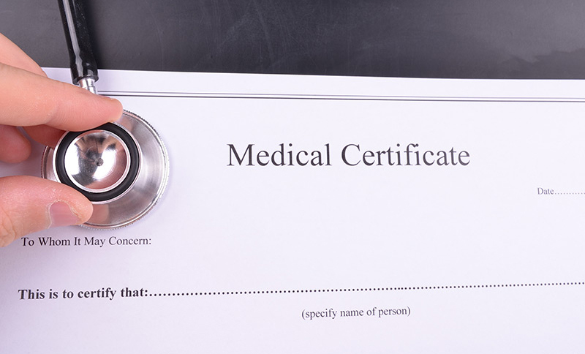
LogiTech Finance & Audit Institute
Requirements for Medical Certification
Vision
Blood Pressure/Pulse Rate
Physical Endurance
Drivers must have at least 20/40 acuity (with or without correction) in each eye and a 70° field of vision. They must also be able to distinguish traffic colors.
Conditions like hypertension are checked to ensure they are well-managed.
Strength, flexibility, and reflexes are tested to ensure the driver can perform physical tasks associated with operating a CMV.
Hearing
Medications
Medical History
Drivers must be able to hear a forced whisper from a distance of 5 feet or less, with or without a hearing aid.
The examiner will review the driver’s medications for potential side effects that might impair driving.
This includes reviewing conditions like diabetes, cardiovascular disease, respiratory issues, neurological disorders, and mental health issues.

Slide 25
Check Listed in National Register
Pre Employment Drug Alcohol Test
3
Motor Vehicle Record
5
7
1
2
4
6
Pre Employment Testing Notification and Consent
CDL
Inquire for State Agency for Personal Data
Medical Certificate
Checklist Company File
Template

Slide 26
LogiTech Finance & Audit Institute
CHECK-LISTED IN NATIONAL REGISTER
Being "check-listed" in the National Register typically refers to the inclusion of a commercial driver’s details in the National Registry of Certified Medical Examiners (National Registry). This registry is an important aspect of ensuring that drivers are physically qualified to operate commercial vehicles.
© 2024 | MASTER CDL

Slide 27
Purpose of the National Registry
To Improve Road Safety
To Enhance Oversight
The registry ensures that medical examiners have the necessary training and knowledge to perform physical examinations according to FMCSA standards.
It provides a system of checks to ensure that examinations are conducted properly and that drivers meet the physical requirements necessary to operate commercial vehicles safely.

Slide 28
Checklist Company File
Template
7
Pre Employment Drug Alcohol Test
Motor Vehicle Record
Check Listed in National Register
1
3
5
CDL
2
4
6
Inquire for State Agency for Personal Data
Medical Certificate
Pre Employment Testing Notification and Consent

Slide 29
LogiTech Finance & Audit Institute
PRE EMPLOYMENT TESTING NOTIFICATION AND CONSENT
Pre-employment testing notification and consent are critical components of the hiring process, especially in industries where safety is paramount, such as trucking. The primary types of pre-employment testing in the trucking industry include drug and alcohol testing, medical examinations, and background checks.
© 2024 | MASTER CDL

Slide 30
Checklist Company File
Template
8
Certificate
of Road Test
Application for Employment
Safety History Records Request
12
14
10
9
11
13
Previous Employment Verification
Drug and Alcohol
Policy
Training Report
Contracts

Slide 31
LogiTech Finance & Audit Institute
PRE EMPLOYMENT TESTING NOTIFICATION AND CONSENT
Previous employment verification for truck drivers is a specialized subset of the general employment verification process, tailored to the specific requirements and concerns of the trucking industry. This process is critical not only for verifying a candidate's qualifications and job history but also for ensuring compliance with industry regulations and safety standards.
© 2024 | MASTER CDL

Slide 32


Specific Aspects of Verifying Employment for Truck Drivers
License Verification:
CDL Status: Confirm that the driver held a valid Commercial Driver's License (CDL) for the types of vehicles they were responsible for.
Endorsements: Verify any special endorsements needed for different types of cargo, such as hazardous materials or tankers.
Safety Performance and History:
Accident Records: Check the driver’s history regarding any road accidents or safety incidents.
Safety Ratings: Inquire about the driver’s safety ratings or any recognitions received from previous employers.
Compliance with Regulations:
DOT Compliance: Ensure that the driver has complied with Department of Transportation (DOT) regulations.
Drug and Alcohol Testing: Verify past drug and alcohol testing results
Employment Duration and Responsibilities:
Specific Roles: Confirm the specific roles and responsibilities the driver had, including the types of loads handled and routes covered.
Reason for Leaving: Understand why the driver left previous employment, which can provide insights into reliability and job performance.
© 2024 LOGISTICS PRO | MASTER CDL

Slide 33
Driver File Checklist
Template
Certificate
of Road Test
8
10
Application for Employment
12
Safety History Records Request
14
11
13
Drug and Alcohol
Policy
Training Report
Contracts
Previous Employment Verification
9

Slide 34
LogiTech Finance & Audit Institute
CERTIFICATE OF ROAD TEST
The Certificate of Road Test is a crucial document in the trucking industry that certifies a commercial vehicle driver has successfully completed a road test and demonstrated the ability to operate a commercial vehicle safely and competently. This certificate is mandated by the Department of Transportation (DOT) under Federal Motor Carrier Safety Regulations (FMCSR), specifically part 391.31.
© 2024 | MASTER CDL

Slide 35
Driver File Checklist
Template
10
Certificate
of Road Test
Application for Employment
8
12
Safety History Records Request
14
9
11
13
Previous Employment Verification
Training Report
Contracts
Drug & Alcohol
Policy

Slide 36
LogiTech Finance & Audit Institute
DRUG & ALCOHOL POLICY
The Drug and Alcohol Policy for truck drivers is a crucial element of regulatory compliance and safety management within the trucking industry. This policy is primarily guided by regulations set forth by the Federal Motor Carrier Safety Administration (FMCSA), part of the U.S. Department of Transportation (DOT). Its primary goal is to prevent accidents and injuries resulting from the misuse of alcohol or use of controlled substances.
© 2024 | MASTER CDL

Slide 37
Driver File Checklist
Template
Application for Employment
Certificate
of Road Test
8
10
12
Safety History Records Request
14
9
13
Previous Employment Verification
Drug & Alcohol
Policy
11
Training Report
Contracts

Slide 38
Driver File Checklist
Template
12
Certificate
of Road Test
Application for Employment
Safety History Records Request
8
10
14
9
11
13
Previous Employment Verification
Drug & Alcohol
Policy
Training Report
Contracts

Slide 39
Driver File Checklist
Template
Safety History Records Request
Certificate
of Road Test
Application for Employment
8
10
12
14
9
11
Previous Employment Verification
Drug & Alcohol
Policy
Training Report
13
Contracts

Slide 40
LogiTech Finance & Audit Institute
SAFETY HISTORY RECORDS REQUEST
The Safety History Records Request is a vital process in the trucking industry, primarily used by employers to assess the safety performance of potential and current truck drivers. This process involves gathering and reviewing various safety-related records to ensure that drivers meet the necessary safety standards. These records help manage risk, improve safety practices, and comply with regulatory requirements.
© 2024 | MASTER CDL

Slide 41
Driving Records (MVRs): Includes citations, tickets, accidents, license suspensions, and other driving-related information.
Previous Employer Records: Under DOT regulations, prospective employers must inquire with the applicant’s former employers from the last three years to obtain details about the driver’s employment history
Components of SHRR
Accident Reports: Details about any accidents the driver has been involved in, typically collected from previous employers or insurance claims.
DOT Drug and Alcohol Clearinghouse:
Employers must query the Clearinghouse as part of pre-employment checks and annually for current employees.

Slide 42
Driver File Checklist
Template
14
Certificate
of Road Test
Application for Employment
Safety History Records Request
8
10
12
9
11
13
Previous Employment Verification
Drug & Alcohol
Policy
Training Report
Contracts

Slide 43
Driver File Checklist
Template
Annual MVR
16
Warning Notice
18
17
15
Annual Certificate of Violation
Termination
Letter

Slide 44
Driver File Checklist
Template
16
18
Annual MVR
Warning Notice
15
17
Annual Certificate of Violation
Termination
Letter

Slide 45
Driver File Checklist
Template
Warning Notice
16
18
Annual MVR
15
Annual Certificate of Violation
17
Termination
Letter

Slide 46
Driver File Checklist
Template
18
16
Annual MVR
Warning Notice
15
17
Annual Certificate of Violation
Termination
Letter

Slide 47




LogiTech Finance & Audit Institute
NEXT:
LESSON 2 - ALL ABOUT DRIVERS
Phone number
Email
+998 330-222-888
info@logitechfinance.com
Website
Social networks (IG)
logitechfinance.com
logitechfinance.com

